Slide 1


Green Pace
Security Policy Presentation
Developer: Aaron Tellez
Green Pace Secure Development Policy

Slide 2

OVERVIEW: DEFENSE IN DEPTH
Why It Was Needed and How It Supports Defense-in-Depth?
Ensures consistent application of secure development principles.
Establishes standardized, enforceable policies across all projects

Slide 3
THREATS MATRIX
Different threats level found in code.
Likely They occur often | Priority They have a high impact
Low priority Limited impact | Unlikely Rare yet possible

Slide 4
10 PRINCIPLES
Validate input data.
Heed Compiler Warnings.
Architect and Design for Security Policies.
Keep it Simple.
Default Deny.
Adhere to the Principle of Least Privilege.
Sanitize Data Sent to Other Systems.
Practice Defense in Depth.
Use Effective Quality Assurance Techniques.
Adopt a Secure Coding Standard.

Slide 5
CODING STANDARDS
Data Type
Data Value
String Correctness
SQL Injection
Memory Protection
Assertions
Exceptions
Input Validation
Variable Naming
Functions

Slide 6
ENCRYPTION POLICIES
Encryption in flight: TLS/SSL
Encryption at rest: XOR
Encryption in use: Importance of encryption.

Slide 7
TRIPLE-A POLICIES
Authentication: Username, password, MFA.
Authorization:
What the user is allowed to do.
Accounting:
What the user do.

Slide 8
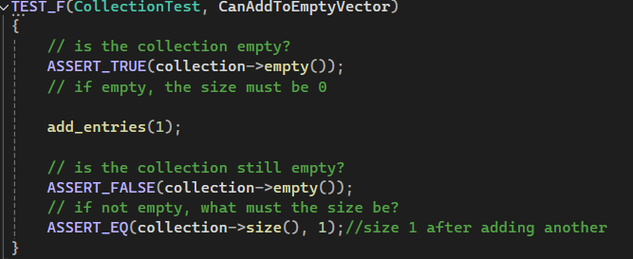
Unit Testing
Unit test 1: Can You Add One Item to an Empty Collection?

Slide 9
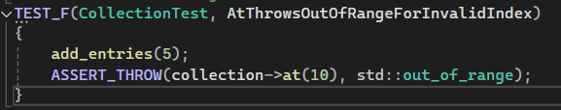
Unit Testing
Unit test 2: What Happens If You Access Index 10 in a 5-Item Collection?

Slide 10
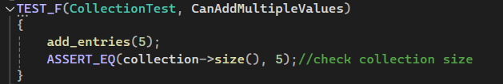
Unit Testing
Unit test 3: Can You Add Multiple Values and Check the Size?

Slide 11
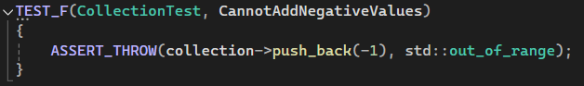
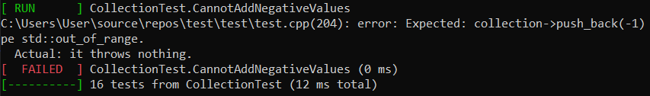
Unit Testing
Unit test 4: Can You Add a Negative Value to the Collection?

Slide 12

AUTOMATION SUMMARY

Slide 13
TOOLS
DevSecOps in C++ integrates security checks into every step of the development lifecycle to catch vulnerabilities early and often.
External tools like Cppcheck, Clang-Tidy, Jenkins, and SonarQube are used throughout the DevSecOps pipeline to automate code checks.

Slide 14
RISKS AND BENEFITS
Lack of Input Validation: Use libraries like std::regex, std::stoi to validate and sanitize inputs.
Ignored Compiler Warnings: Treat warnings as errors and resolve them immediately.
Weak Architectural Design: Follow security-focused design patterns from the start.
Complex Code: Write modular, readable code and avoid unsafe features like raw pointers.
Overly Permissive Access: Set strict access controls by default, granting access only as needed.
Excess Privilege: Run programs with restricted permissions using user roles and capabilities.

Slide 15
RECOMMENDATIONS
Use appropriate data types for variables.
Do not use object representations to compare floating-point values.
Do not attempt to modify string literals.
Use bound parameters to safely pass user input to SQL queries.
Declare objects with appropriate storage durations.
Assertions should be used for conditions that should never happen in a running program.
Handle all exceptions.
Always validate user inputs to prevent invalid data or security vulnerabilities.
Input validation, validate external input to ensure it meets expected formats and ranges.
Use meaningful variable names.
Use Functions Instead of Repetitive Code.

Slide 16
CONCLUSIONS
Data Integrity, ensures that the correct data type is used for variables.
Correctness, ensures that comparisons are done in a way that guarantees accurate results.
Consistency, avoiding undefined behavior by preventing direct modification of string literals.
Security First, protect sensitive data to ensure data integrity.
Fail-safe defaults, ensures correct storage duration.
Fail-fast design, prevents undefined behavior and helps catch logic errors before the application goes into production.
Reliability, ensures the program remains stable and can recover gracefully from unexpected errors.
Input validation, validate external input to ensure it meets expected formats and ranges.
Code readability and maintainability, ensures clear and descriptive variable names makes the code easier to understand, debug, and update in the future.
Avoid code repetition, reusing functions avoids code duplication and simplifies maintenance if changes are needed later.

Slide 17
REFERENCES
Sheila et all. (2024). SEI CERT C++ Coding Standard. Carnegie Mellon University
https://wiki.sei.cmu.edu/confluence/pages/viewpage.action?pageId= 88046682

